Slide 1
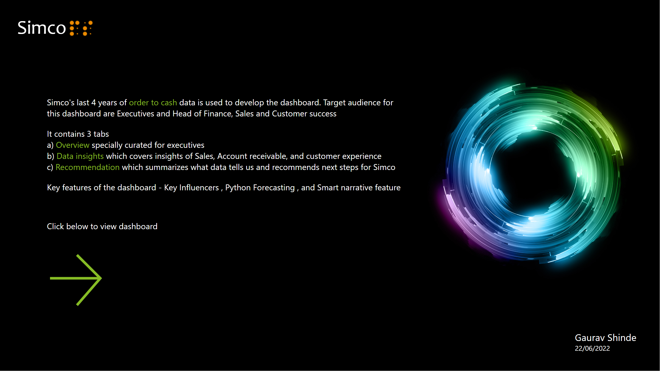
Landing page
Notes:
textbox
No alt text provided
textbox
No alt text provided
textbox
No alt text provided
image
No alt text provided
actionButton
No alt text provided
image
No alt text provided
textbox
No alt text provided

Slide 2
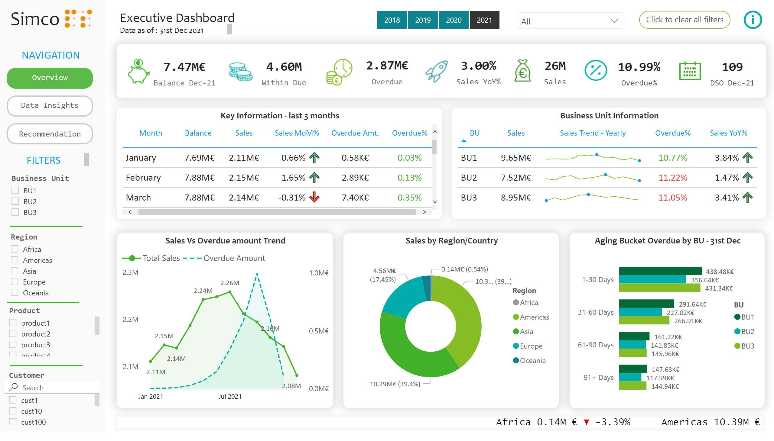
Executive Dashboard V5
Notes:
textbox
No alt text provided
textbox
No alt text provided
textbox
No alt text provided
textbox
No alt text provided
actionButton
No alt text provided
card
No alt text provided
card
No alt text provided
card
No alt text provided
Aging Bucket Overdue by BU - 31st Dec
No alt text provided
textbox
No alt text provided
card
No alt text provided
card
No alt text provided
card
No alt text provided
card
No alt text provided
actionButton
No alt text provided
textbox
No alt text provided
Key Information - last 3 months
No alt text provided
Sales by Region/Country
No alt text provided
Business Unit Information
No alt text provided
Sales Vs Overdue amount Trend
No alt text provided
slicer
No alt text provided
slicer
No alt text provided
slicer
No alt text provided
shape
No alt text provided
shape
No alt text provided
slicer
No alt text provided
actionButton
No alt text provided
Click to clear all filters
No alt text provided
slicer
No alt text provided
actionButton
No alt text provided
slicer
No alt text provided
shape
No alt text provided
ScrollingTextVisual1448795304508
No alt text provided
image
No alt text provided
image
No alt text provided
image
No alt text provided
image
No alt text provided
image
No alt text provided
image
No alt text provided
textbox
No alt text provided
image
No alt text provided
image
No alt text provided

Slide 3
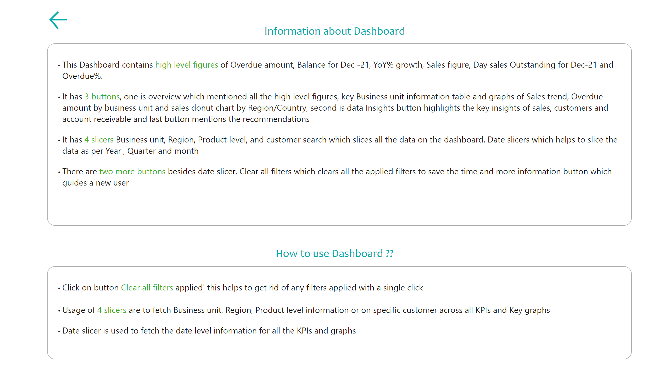
More Information
Notes:
textbox
No alt text provided
textbox
No alt text provided
textbox
No alt text provided
textbox
No alt text provided
actionButton
No alt text provided

Slide 4
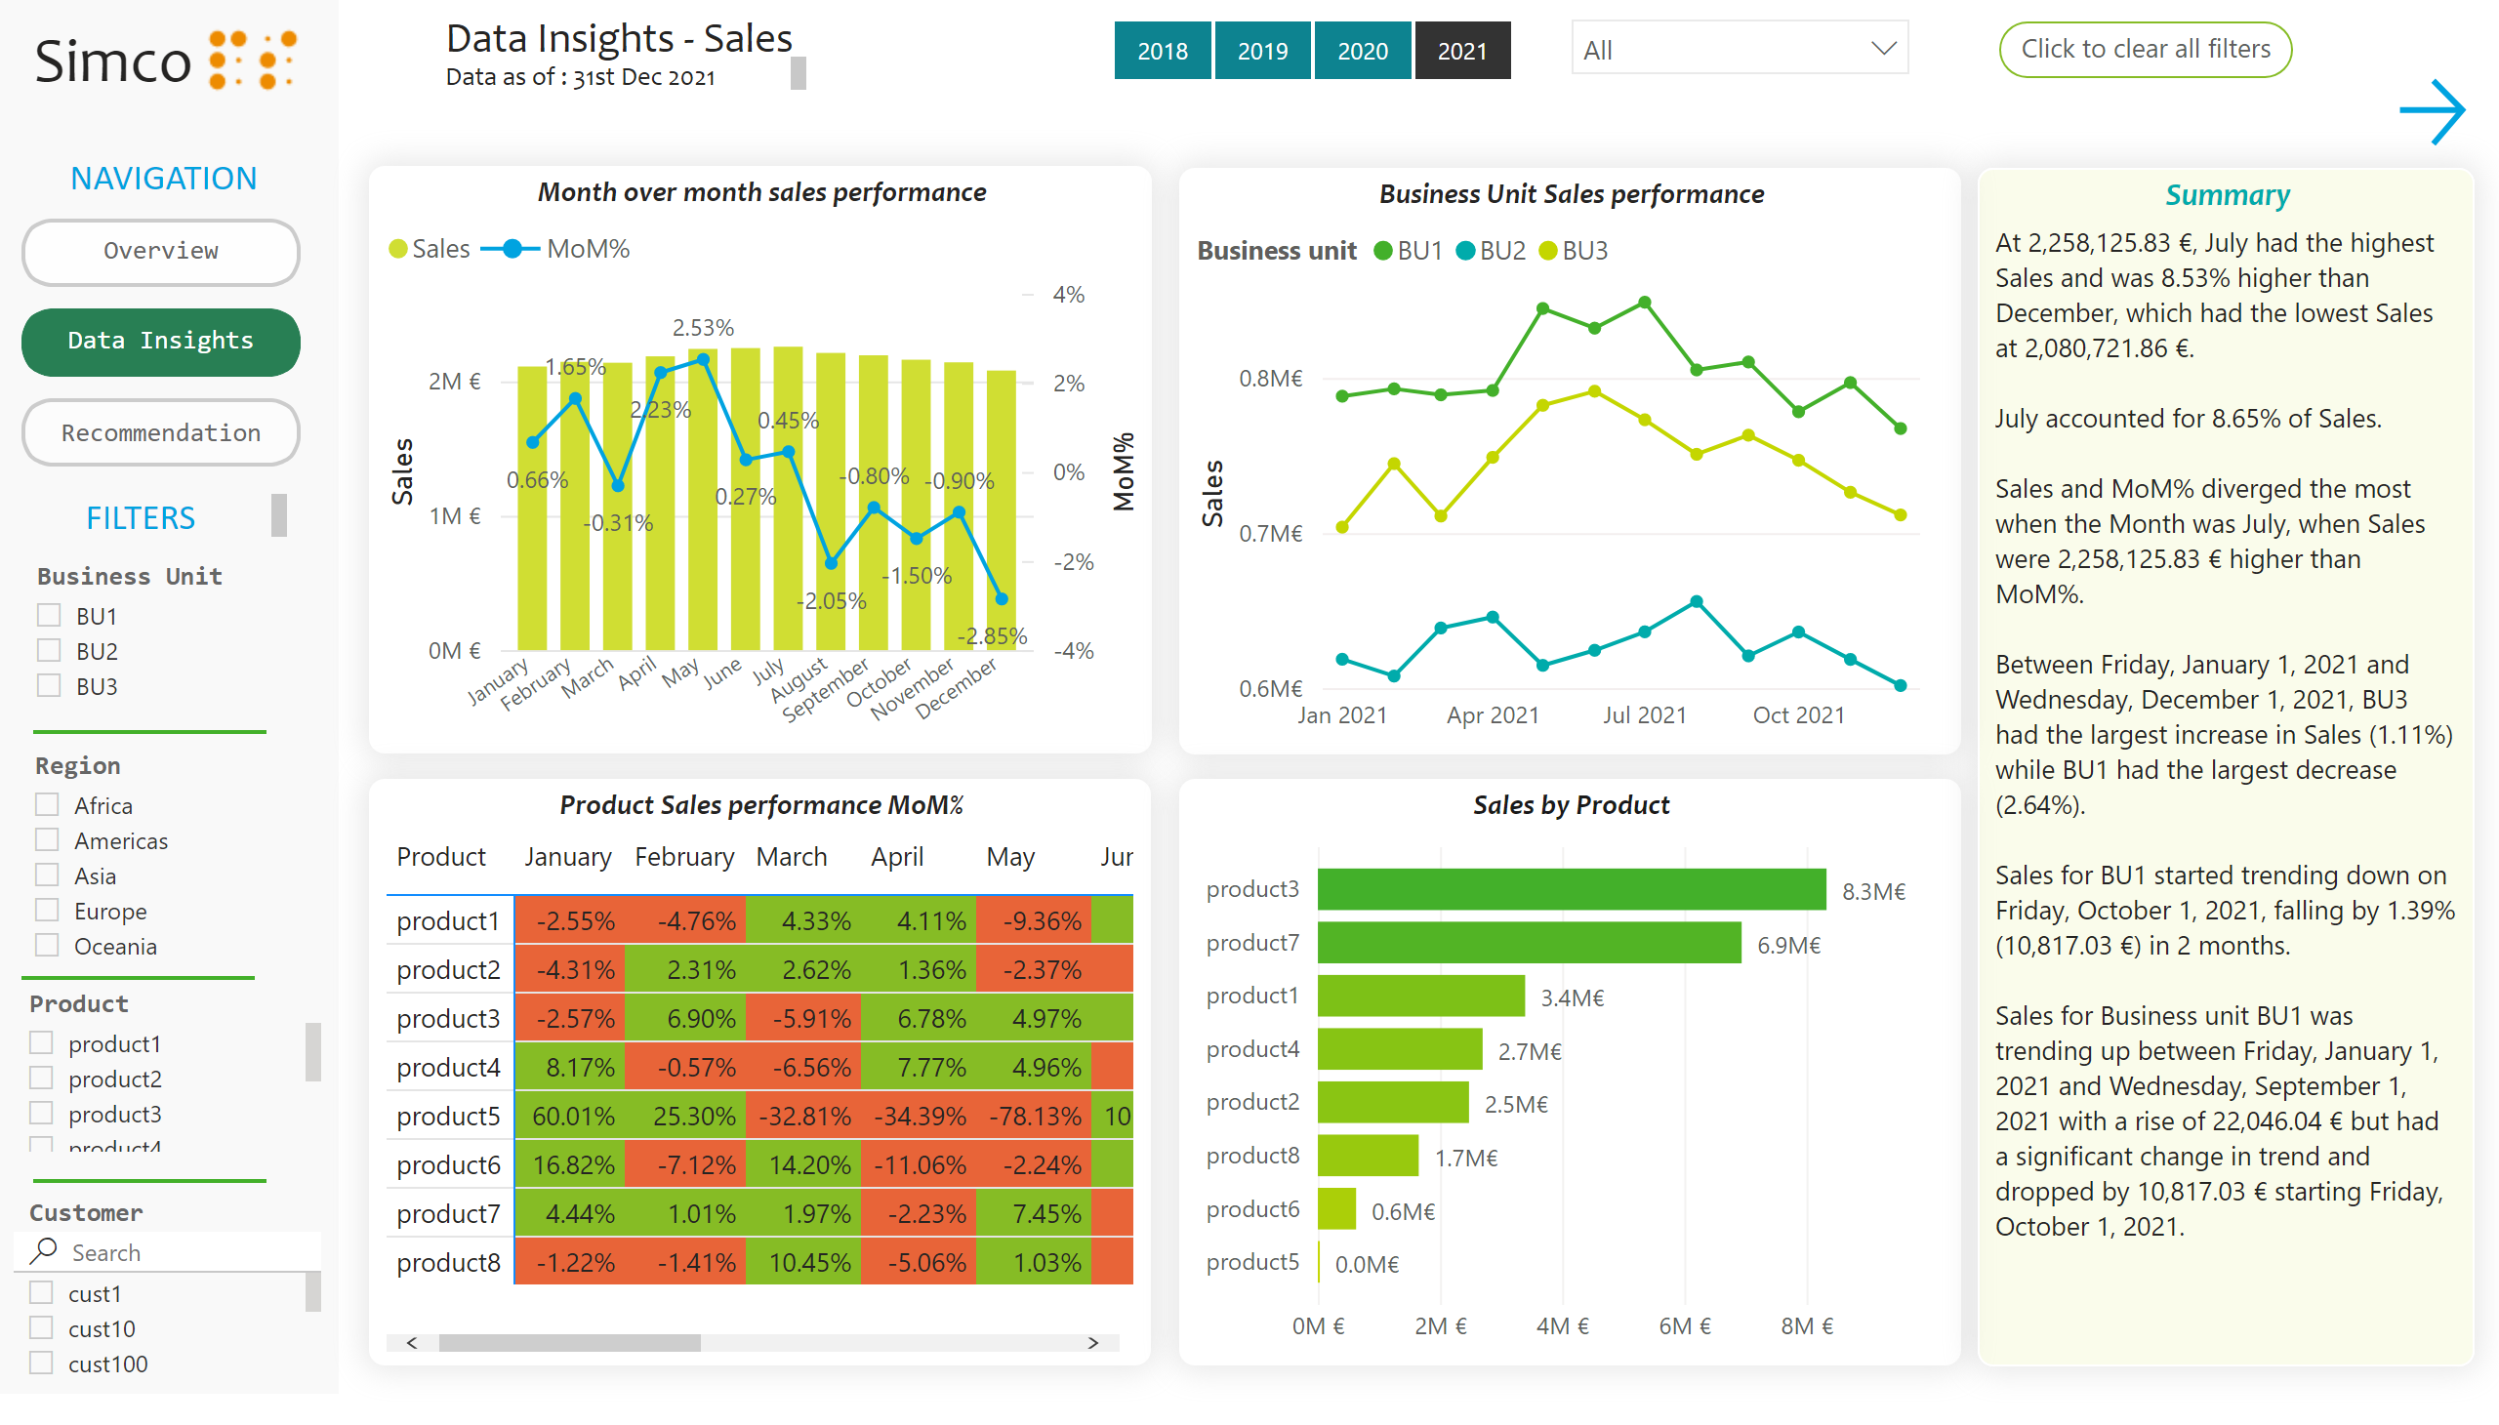
Data Insights - sales
Notes:
textbox
No alt text provided
textbox
No alt text provided
textbox
No alt text provided
actionButton
No alt text provided
textbox
No alt text provided
actionButton
No alt text provided
textbox
No alt text provided
slicer
No alt text provided
slicer
No alt text provided
slicer
No alt text provided
shape
No alt text provided
shape
No alt text provided
slicer
No alt text provided
Click to clear all filters
No alt text provided
slicer
No alt text provided
actionButton
No alt text provided
slicer
No alt text provided
shape
No alt text provided
textbox
No alt text provided
image
No alt text provided
Month over month sales performance
No alt text provided
Business Unit Sales performance
No alt text provided
Product Sales performance MoM%
No alt text provided
Sales by Product
No alt text provided
Summary
No alt text provided
actionButton
No alt text provided

Slide 5
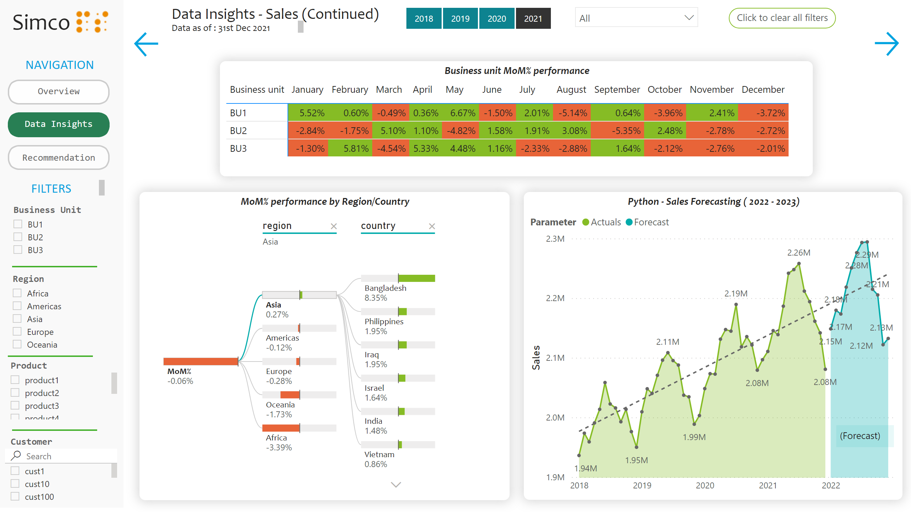
Data Insights - Sales 2
Notes:
textbox
No alt text provided
textbox
No alt text provided
textbox
No alt text provided
actionButton
No alt text provided
textbox
No alt text provided
actionButton
No alt text provided
textbox
No alt text provided
slicer
No alt text provided
slicer
No alt text provided
slicer
No alt text provided
shape
No alt text provided
shape
No alt text provided
slicer
No alt text provided
Click to clear all filters
No alt text provided
slicer
No alt text provided
actionButton
No alt text provided
slicer
No alt text provided
shape
No alt text provided
textbox
No alt text provided
image
No alt text provided
actionButton
No alt text provided
MoM% performance by Region/Country
No alt text provided
actionButton
No alt text provided
Business unit MoM% performance
No alt text provided
Python - Sales Forecasting ( 2022 - 2023)
No alt text provided
textbox
No alt text provided

Slide 6
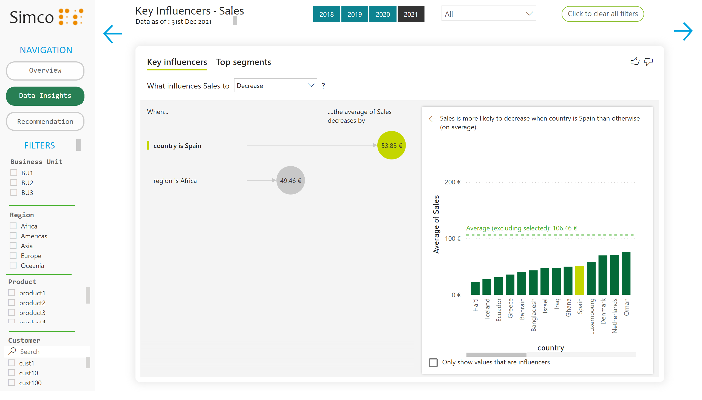
Key Influencers - sales
Notes:
textbox
No alt text provided
textbox
No alt text provided
textbox
No alt text provided
actionButton
No alt text provided
textbox
No alt text provided
actionButton
No alt text provided
textbox
No alt text provided
slicer
No alt text provided
slicer
No alt text provided
slicer
No alt text provided
shape
No alt text provided
shape
No alt text provided
slicer
No alt text provided
Click to clear all filters
No alt text provided
slicer
No alt text provided
actionButton
No alt text provided
slicer
No alt text provided
shape
No alt text provided
textbox
No alt text provided
image
No alt text provided
actionButton
No alt text provided
keyDriversVisual
No alt text provided
actionButton
No alt text provided

Slide 7
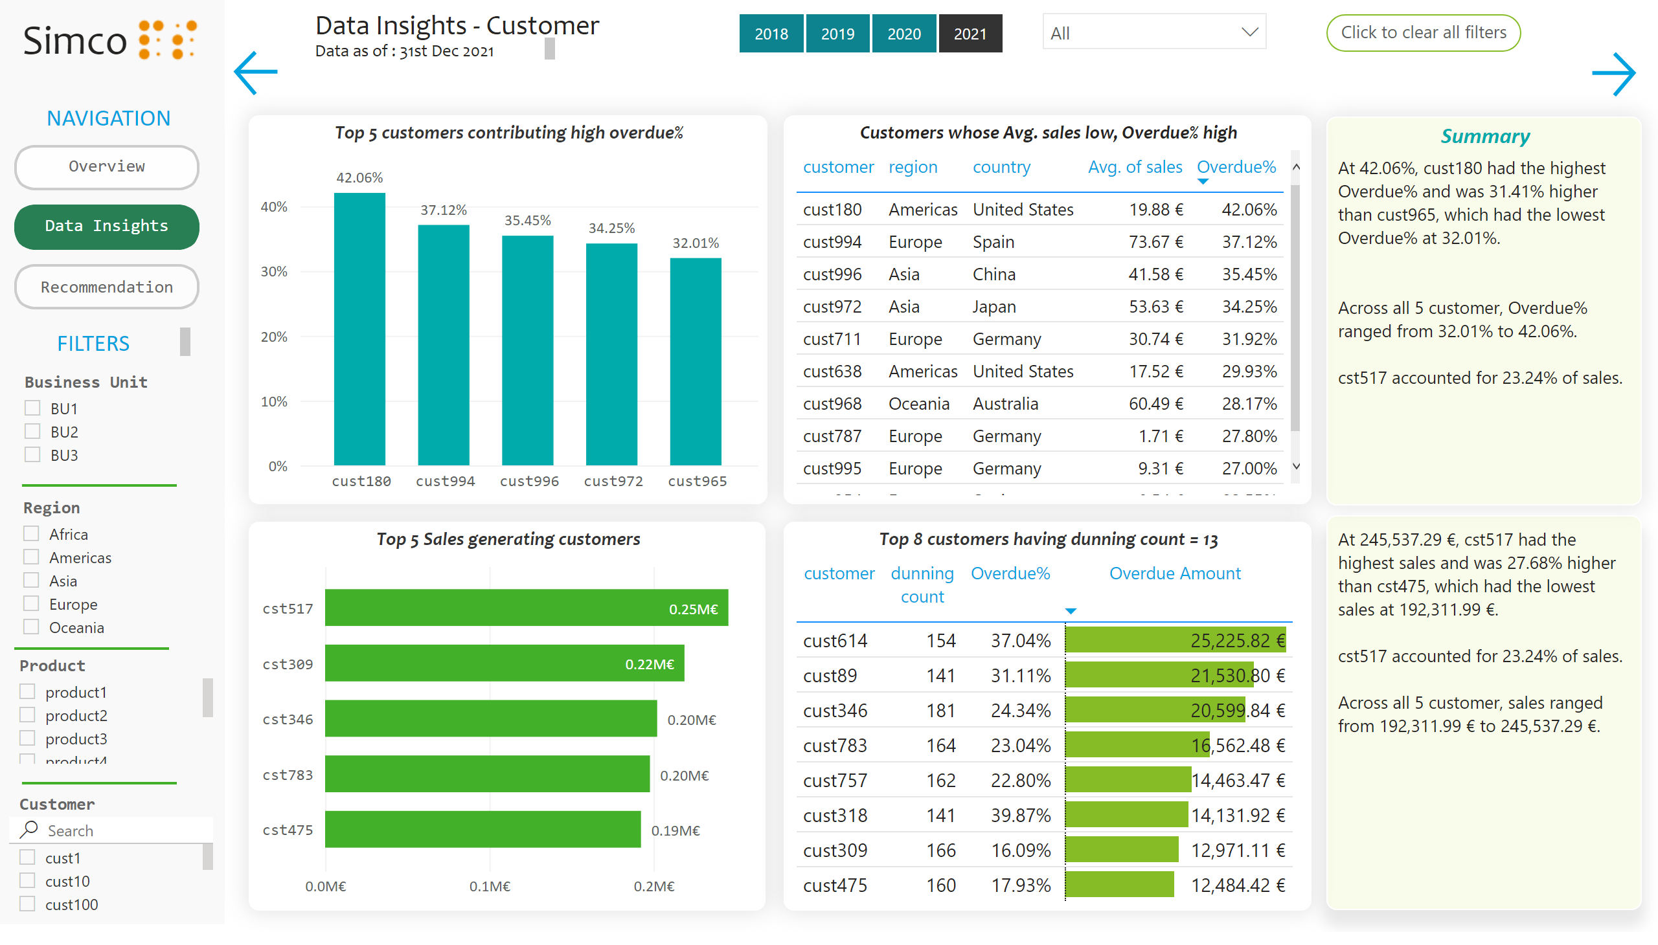
Data Insights - Customer
Notes:
textbox
No alt text provided
textbox
No alt text provided
textbox
No alt text provided
actionButton
No alt text provided
textbox
No alt text provided
actionButton
No alt text provided
textbox
No alt text provided
slicer
No alt text provided
slicer
No alt text provided
slicer
No alt text provided
shape
No alt text provided
shape
No alt text provided
slicer
No alt text provided
Click to clear all filters
No alt text provided
slicer
No alt text provided
actionButton
No alt text provided
slicer
No alt text provided
shape
No alt text provided
textbox
No alt text provided
image
No alt text provided
actionButton
No alt text provided
Top 5 customers contributing high overdue%
No alt text provided
Customers whose Avg. sales low, Overdue% high
No alt text provided
Top 5 Sales generating customers
No alt text provided
Top 8 customers having dunning count = 13
No alt text provided
Summary
No alt text provided
textbox
No alt text provided
actionButton
No alt text provided

Slide 8
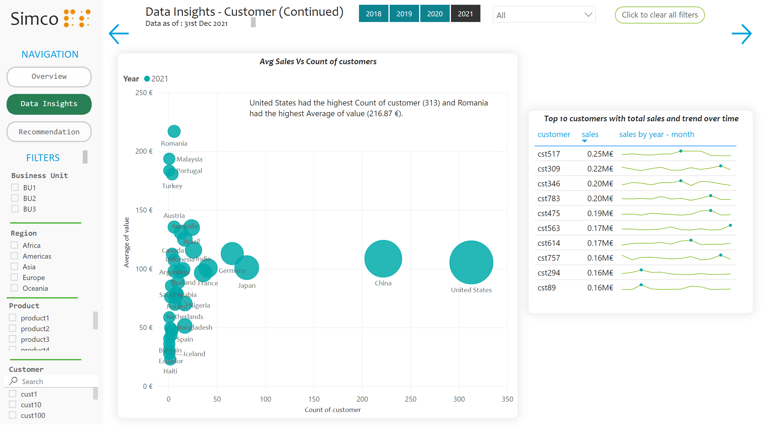
Data Insights - Customer 2
Notes:
textbox
No alt text provided
textbox
No alt text provided
textbox
No alt text provided
actionButton
No alt text provided
textbox
No alt text provided
actionButton
No alt text provided
textbox
No alt text provided
slicer
No alt text provided
slicer
No alt text provided
slicer
No alt text provided
shape
No alt text provided
shape
No alt text provided
slicer
No alt text provided
Click to clear all filters
No alt text provided
slicer
No alt text provided
actionButton
No alt text provided
slicer
No alt text provided
shape
No alt text provided
textbox
No alt text provided
image
No alt text provided
actionButton
No alt text provided
actionButton
No alt text provided
Avg Sales Vs Count of customers
No alt text provided
textbox
No alt text provided
Top 10 customers with total sales and trend over time
No alt text provided

Slide 9
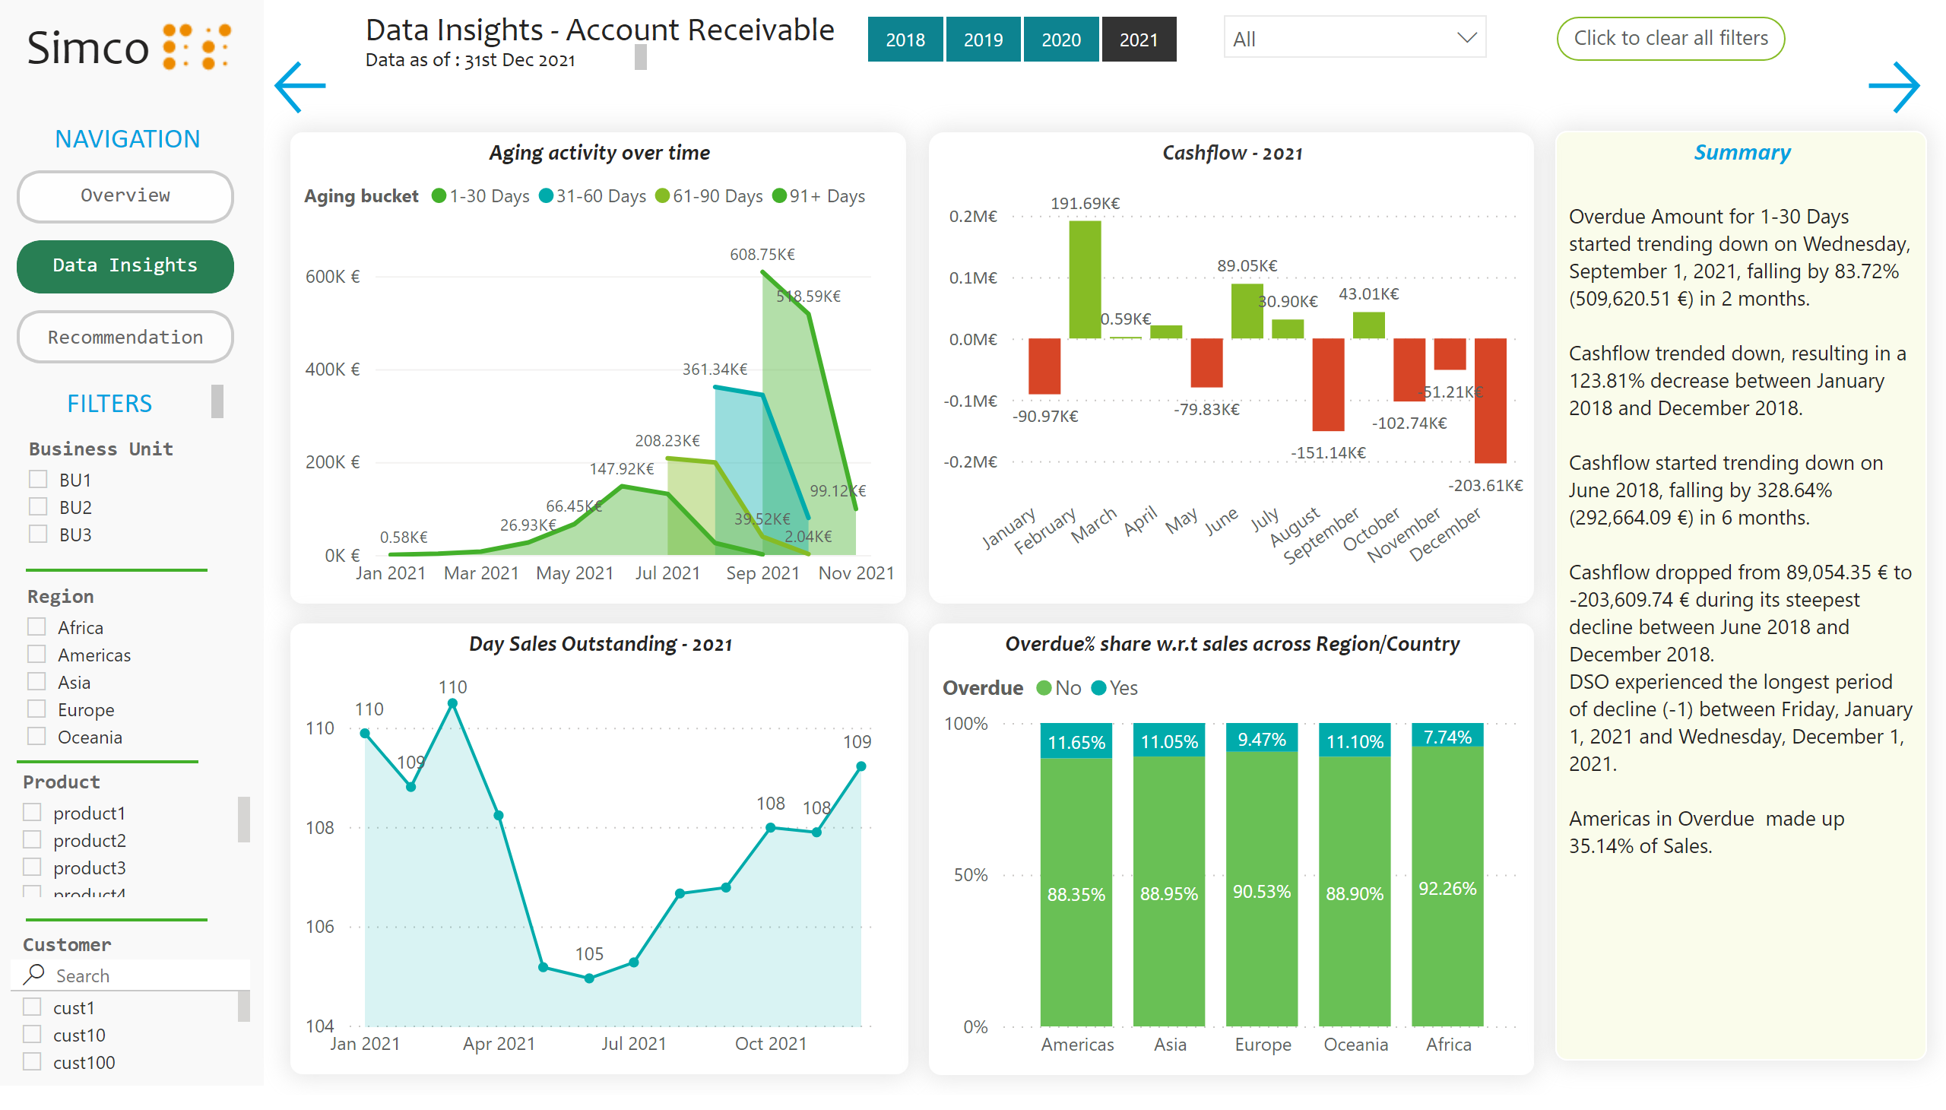
Data Insights - AR
Notes:
textbox
No alt text provided
textbox
No alt text provided
textbox
No alt text provided
actionButton
No alt text provided
textbox
No alt text provided
actionButton
No alt text provided
textbox
No alt text provided
slicer
No alt text provided
slicer
No alt text provided
slicer
No alt text provided
shape
No alt text provided
shape
No alt text provided
slicer
No alt text provided
Click to clear all filters
No alt text provided
slicer
No alt text provided
actionButton
No alt text provided
slicer
No alt text provided
shape
No alt text provided
textbox
No alt text provided
image
No alt text provided
actionButton
No alt text provided
actionButton
No alt text provided
Aging activity over time
No alt text provided
Cashflow - 2021
No alt text provided
Day Sales Outstanding - 2021
No alt text provided
Overdue% share w.r.t sales across Region/Country
No alt text provided
Summary
No alt text provided

Slide 10
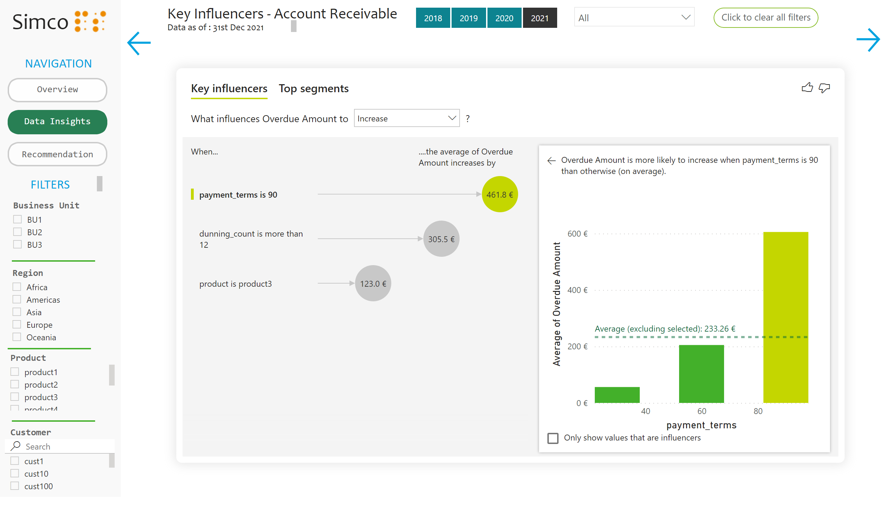
Key influencers - AR
Notes:
textbox
No alt text provided
textbox
No alt text provided
textbox
No alt text provided
actionButton
No alt text provided
textbox
No alt text provided
actionButton
No alt text provided
textbox
No alt text provided
slicer
No alt text provided
slicer
No alt text provided
slicer
No alt text provided
shape
No alt text provided
shape
No alt text provided
slicer
No alt text provided
Click to clear all filters
No alt text provided
slicer
No alt text provided
actionButton
No alt text provided
slicer
No alt text provided
shape
No alt text provided
textbox
No alt text provided
image
No alt text provided
actionButton
No alt text provided
actionButton
No alt text provided
keyDriversVisual
No alt text provided

Slide 11
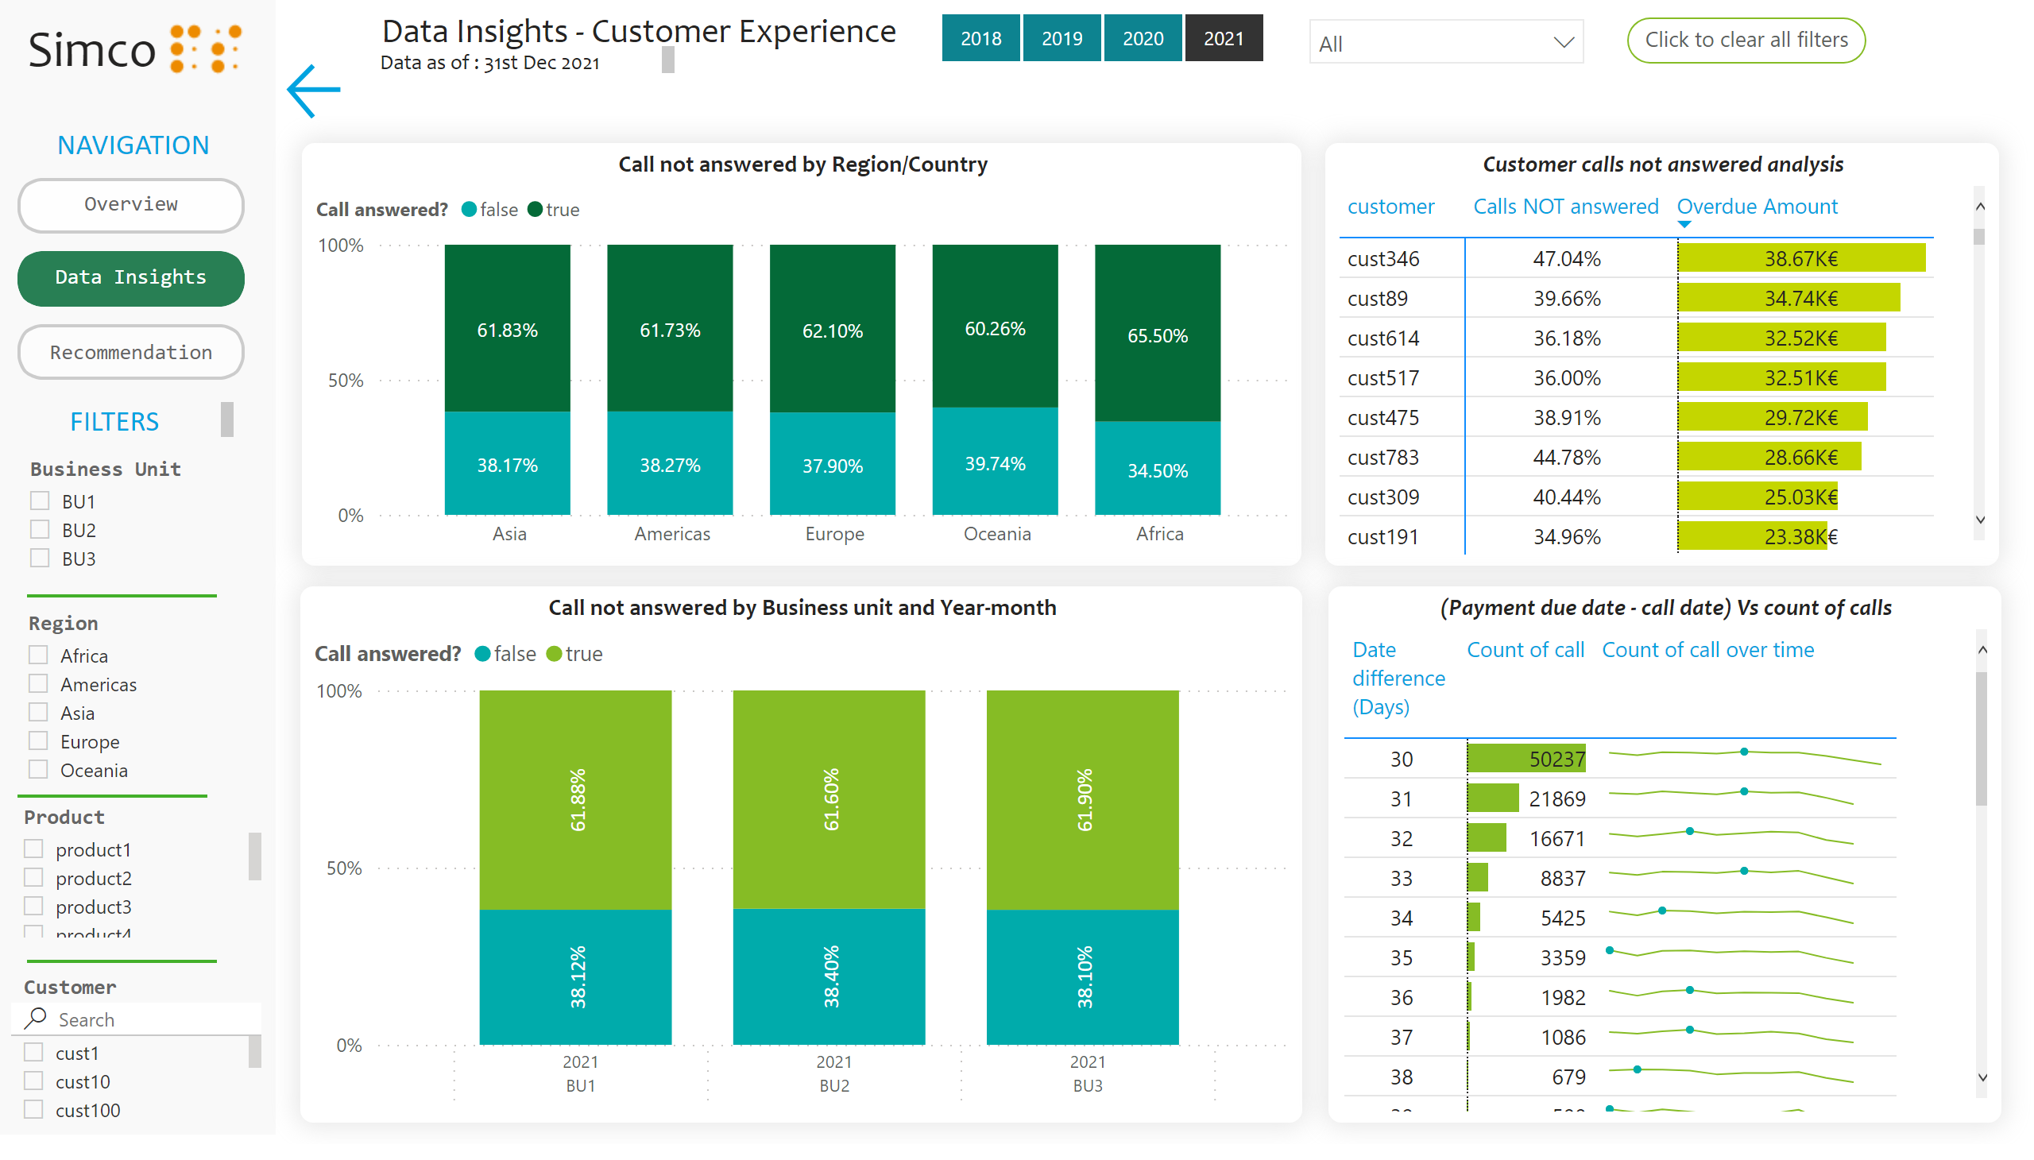
Data Insights - CX
Notes:
textbox
No alt text provided
textbox
No alt text provided
textbox
No alt text provided
actionButton
No alt text provided
textbox
No alt text provided
actionButton
No alt text provided
textbox
No alt text provided
slicer
No alt text provided
slicer
No alt text provided
slicer
No alt text provided
shape
No alt text provided
shape
No alt text provided
slicer
No alt text provided
Click to clear all filters
No alt text provided
slicer
No alt text provided
actionButton
No alt text provided
slicer
No alt text provided
shape
No alt text provided
textbox
No alt text provided
image
No alt text provided
actionButton
No alt text provided
Call not answered by Region/Country
No alt text provided
Customer calls not answered analysis
No alt text provided
Call not answered by Business unit and Year-month
No alt text provided
(Payment due date - call date) Vs count of calls
No alt text provided

Slide 12
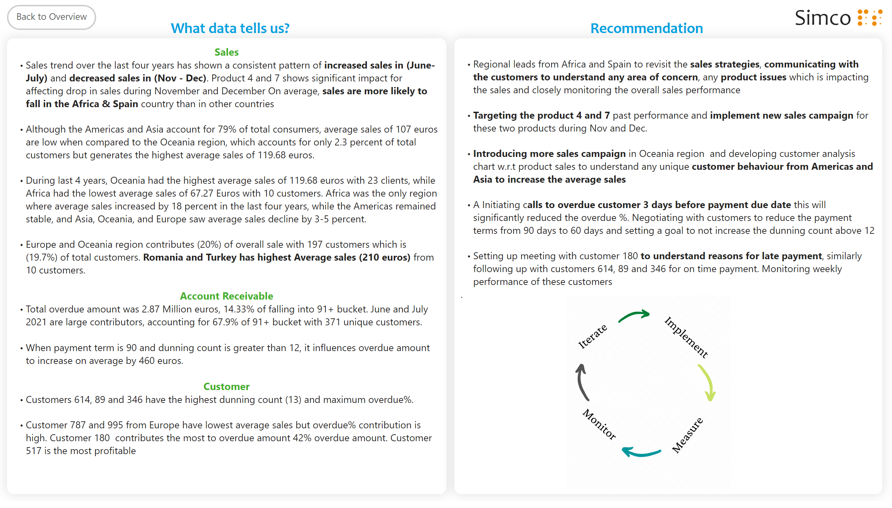
Recommendation
Notes:
textbox
No alt text provided
textbox
No alt text provided
actionButton
No alt text provided
textbox
No alt text provided
textbox
No alt text provided
image
No alt text provided
textbox
No alt text provided
areaChart
No alt text provided

